Slide 1
Preprocessing Size
Any variables or storage assigned for computation of the protocol apart from input(x, x1, x2), key(K,k1,k2), Radomization matrix(Rmat) and output are considered towards preprocessing size.
Since centralized implementation didn’t use any ”extra” variables, their preprocessing size are not shown.

Slide 2
TCC’18 with packed
Files:
PRF.cpp
Toeplitz-by-x.cpp
OT.cpp
PackedMod2.hpp
Functions | Variables | Size
Preproc_Toeplitz-by-x() | rAs, rbs, rzs, rxs | 2n+n+n+n = 4n
Preproc_OT | raps, rbps, zps, rxps | 4n
 |  | 8n = 2048

Slide 3
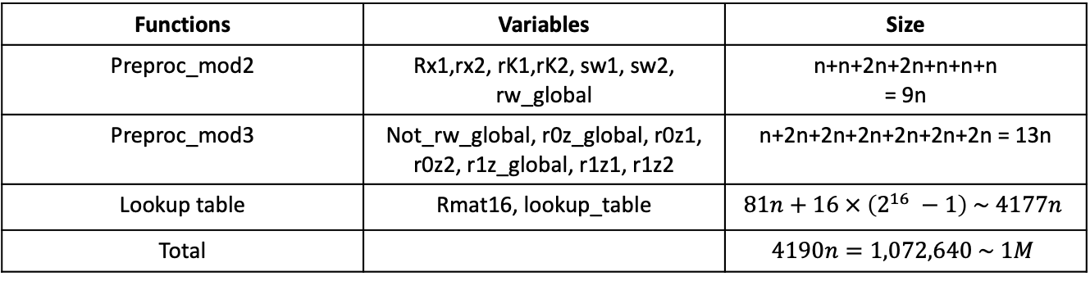
Fully Distributed (packed)
Files:
new_protocol.cpp
PackedMod2.hpp
PackedMod3.hpp
Functions | Variables | Size
Preproc_mod2 | Rx1,rx2, rK1,rK2, sw1, sw2, rw_global | n+n+2n+2n+n+n+n = 9n
Preproc_mod3 | Not_rw_global, r0z_global, r0z1, r0z2, r1z_global, r1z1, r1z2 | n+2n+2n+2n+2n+2n+2n = 13n
Total |  | 22n = 5632 ~ 6K
Fully Distributed (packed+lookup)
Functions | Variables | Size
Preproc_mod2 | Rx1,rx2, rK1,rK2, sw1, sw2, rw_global | n+n+2n+2n+n+n+n = 9n
Preproc_mod3 | Not_rw_global, r0z_global, r0z1, r0z2, r1z_global, r1z1, r1z2 | n+2n+2n+2n+2n+2n+2n = 13n
Lookup table | Rmat16, lookup_table | $$81n+16 × \left(2^{16} −1\right) \sim 4177n$$
Total |  | $$4190n=1,072,640 \sim 1M$$

Slide 4
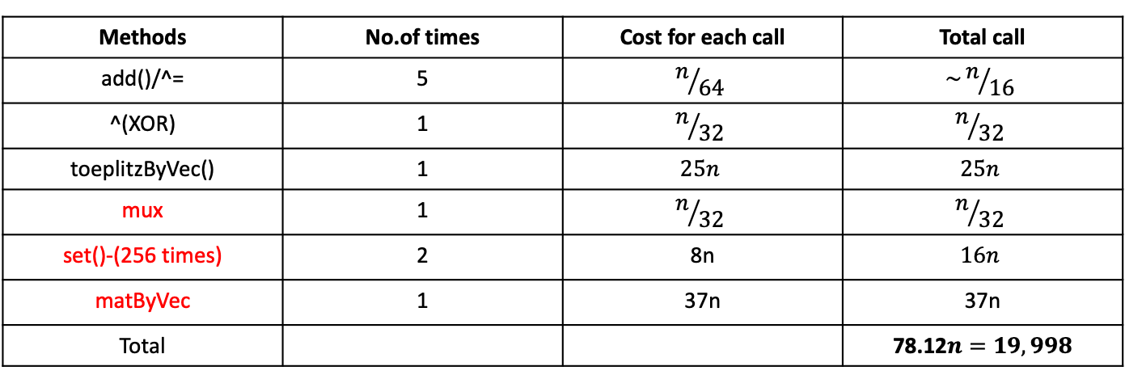
oPRF (packed)
Files:
OPRF.cpp
PackedMod2.hpp
PackedMod3.hpp
Methods | No.of times | Cost for each call | Total call
add()/^= | 5 | $$n/{64}$$ | $$\sim n/{16}$$
^(XOR) | 1 | $$n/{32}$$ | $$n/{32}$$
toeplitzByVec() | 1 | $$25n$$ | $$25n$$
mux | 1 | $$n/{32}$$ | $$n/{32}$$
set()-(256 times) | 2 | 8n | $$16n$$
matByVec | 1 | 37n | 37n
Total |  |  | 78.12$n=19,998$

Slide 5
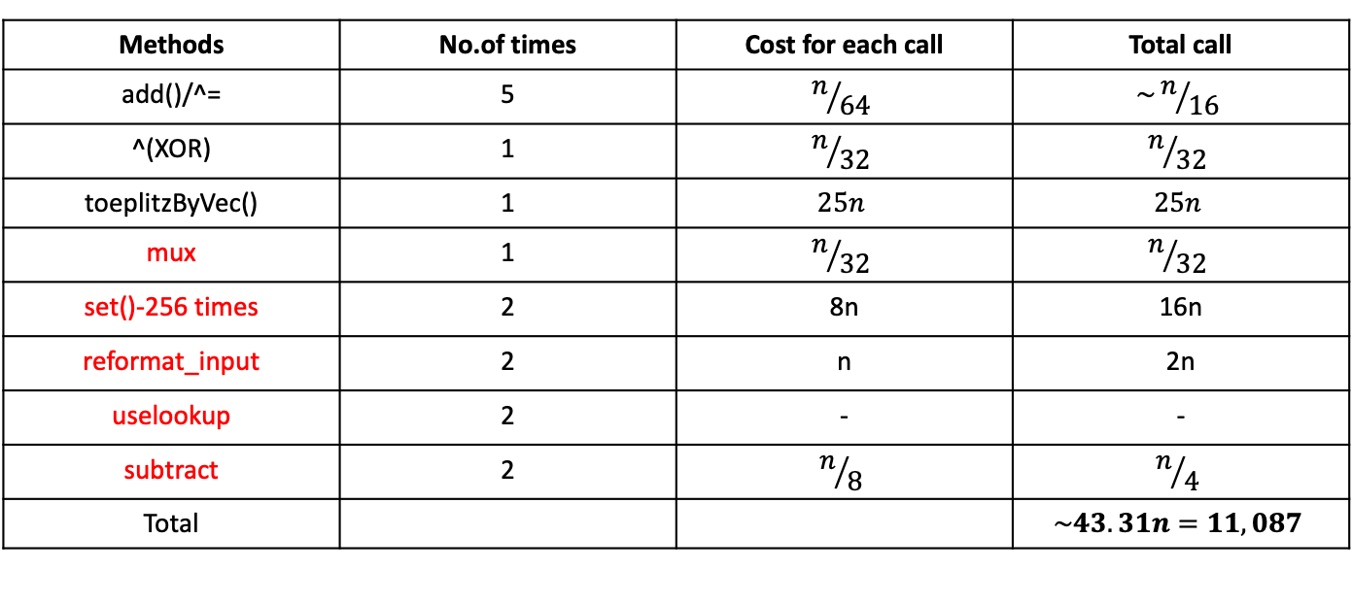
oPRF (packed + lookup)
Files:
OPRF.cpp
lookup_function.cpp
PackedMod2.hpp
PackedMod3.hpp
Methods | No.of times | Cost for each call | Total call
add()/^= | 5 | $$n/{64}$$ | $$\sim n/{16}$$
^(XOR) | 1 | $$n/{32}$$ | $$n/{32}$$
toeplitzByVec() | 1 | $$25n$$ | $$25n$$
mux | 1 | $$n/{32}$$ | $$n/{32}$$
set()-256 times | 2 | 8n | 16n
reformat_input | 2 | n | 2n
uselookup | 2 | - | -
subtract | 2 | $$n/8$$ | $$n/4$$
Total |  |  | $$\sim 43.31n=11,087$$

Slide 6

DIDO(Fully Distributed with packed)
party1_round_1: 9 operations
Party2_round_1: same
Both K, $Rk_{1}$ are Toeplitz

